Slide 1
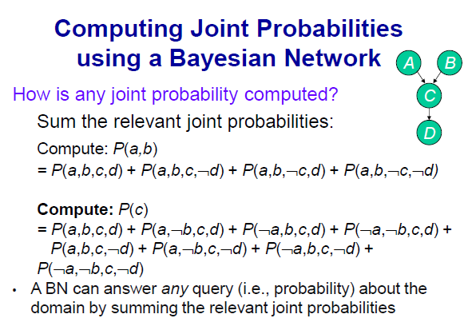

Slide 2
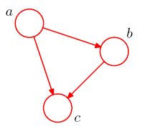
8.1 Bayesian network (Bishop)
Given three variable a, b, c
p(a,b,c) = p(c|a,b)p(a,b) = p(c|a,b)p(b|a)p(a) on the right-hand side by product rule
Different order of a,b,c on p(a,b,c) makes different graphical representation.
The Representation is NOT unique!
K variables
Directed acyclic graphs (DAGs)
Restriction: no directed cycles
Fully connected graph

Slide 3
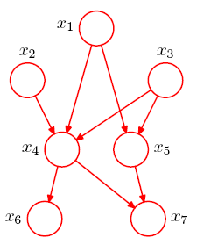
Bayesian network
The joint distribution defined by a graph is given by the product of a conditional distribution of each node conditioned on their parent nodes.
Example)
The joint distribution of all 7 variables is given by
denotes the set of parents of x_{k}

Slide 4



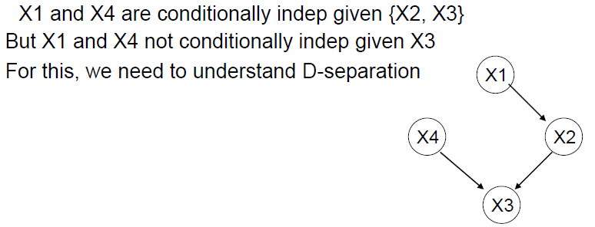
8.2 Conditional Independence
Conditional independence simplifies both the structure of a model and the computations
An important feature of graphical models is that conditional independence properties of the joint distribution can be read directly from the graph without having to perform any analytical manipulations
The general framework for this is called d-separation
Each node is conditionally independent of its non-descendents,
given its immediate parents.

Slide 5
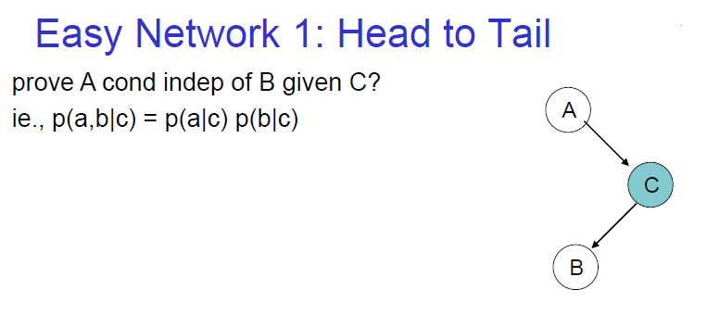
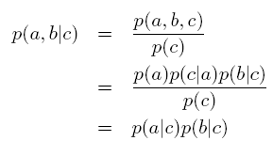

The conditioned node ‘blocks’ the path from a to b causes a and b to become (conditionally) independent

Slide 6
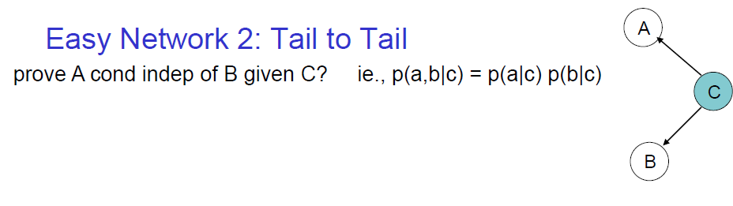


The conditioned node ‘blocks’ the path from a to b causes a and b to become (conditionally) independent.

Slide 7
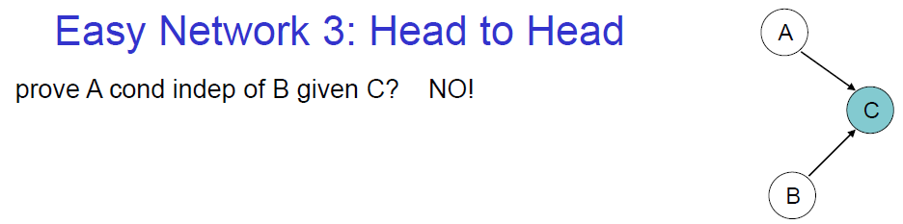
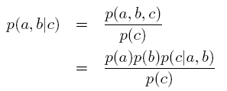

Conditioning on c ‘unblocks’ the path and render a and b dependent

Slide 8
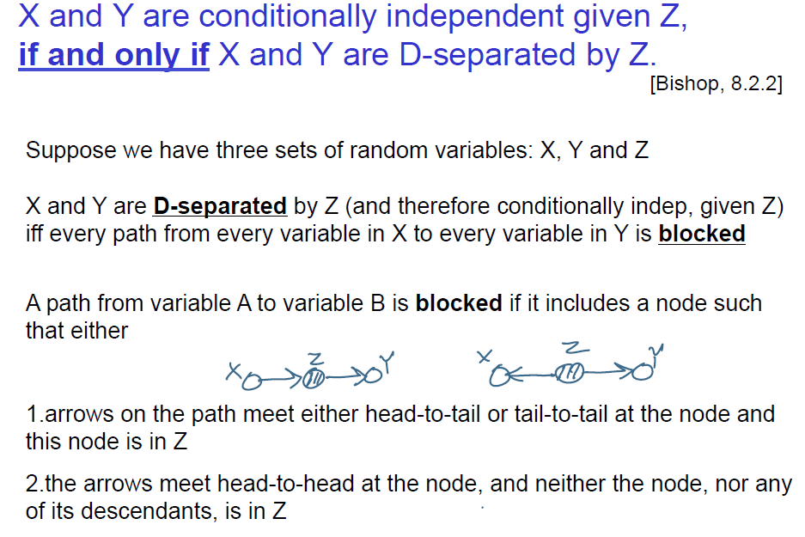

Slide 9
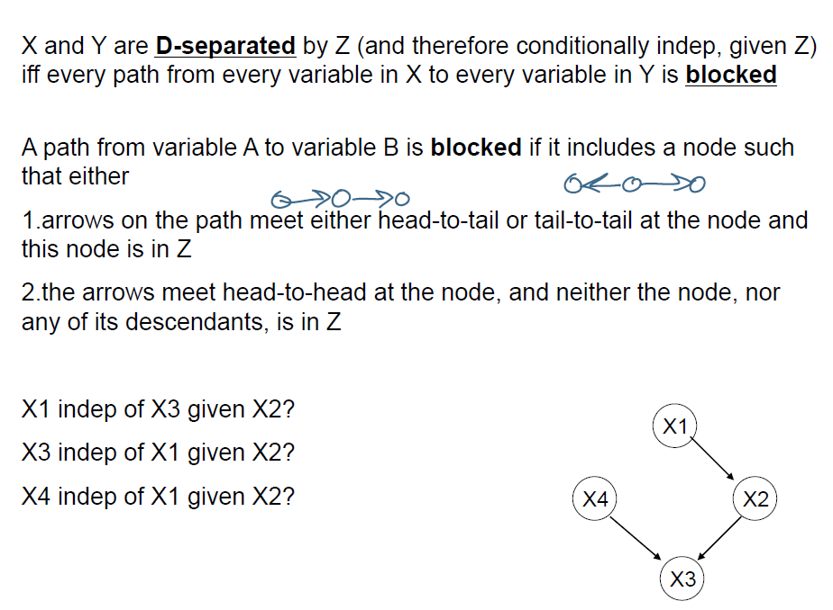

Slide 10
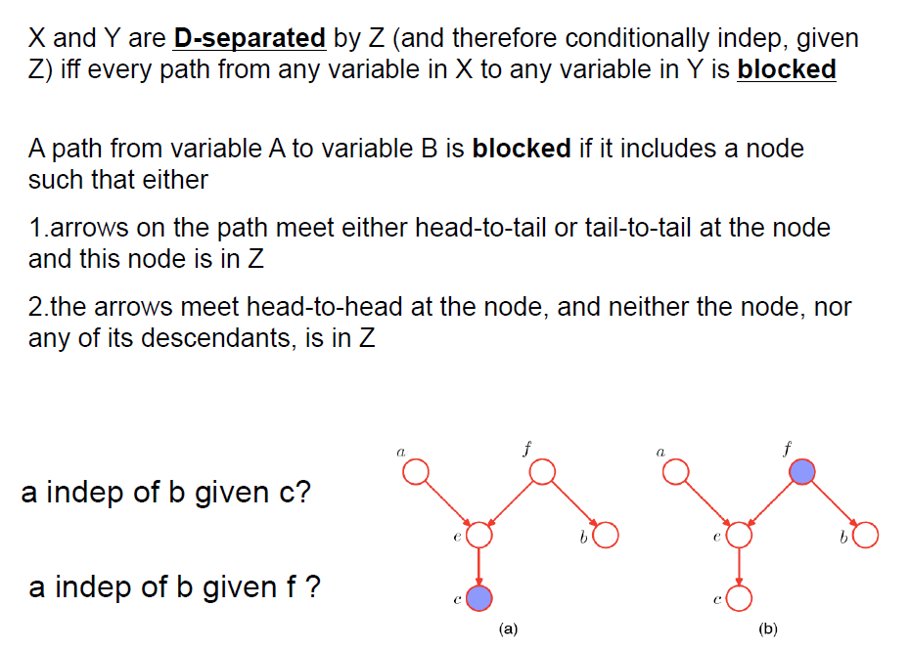

Slide 11
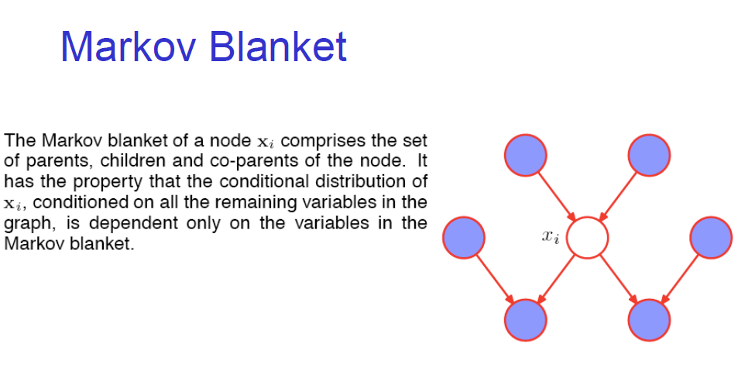

Slide 12
Inference by Variable Elimination

Slide 13
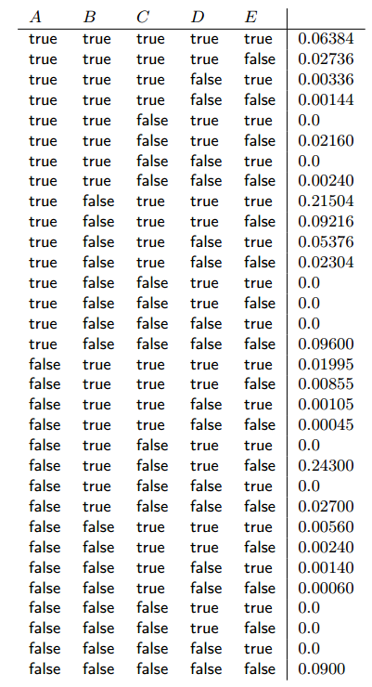
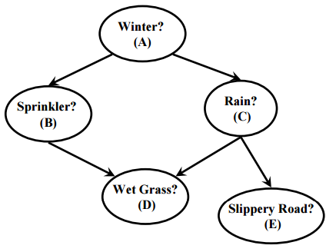
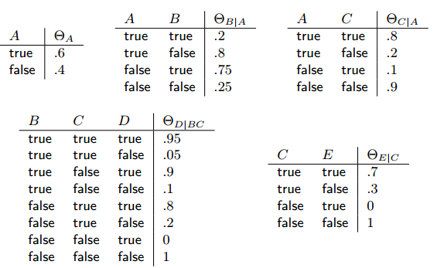
Joint probability distribution induced by BN

Slide 14
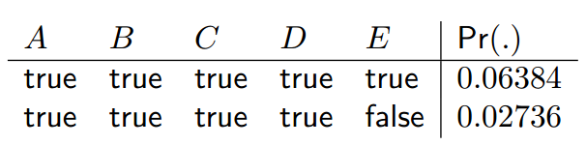
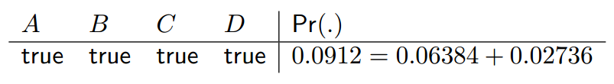
Summing out variables from a probability distribution
To sum out the variable E
P(A=t, B=t, C=t, D=t) =

Slide 15
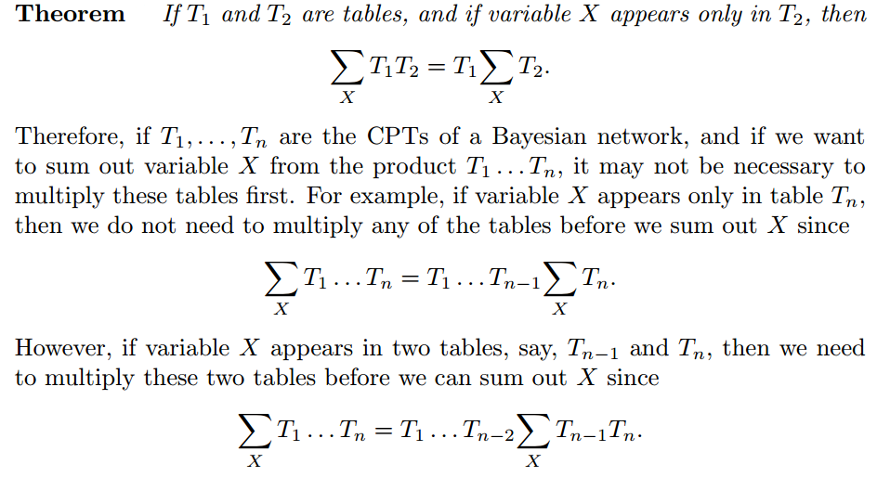

Slide 16
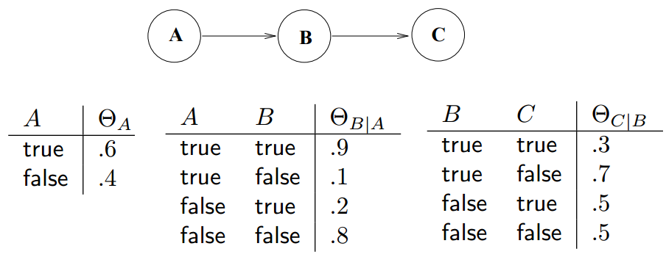
A Bayesian Network
P(C=1)
P(C=1)= (.6*.9*.3)+(.6*.1*.5)+(.4*.2*.3)+(.4*.8*.5)= 0.3760
P(C=0)= (.6*.9*.7)+(.6*.1*.5)+(.4*.2*.7)+(.4*.8*.5) = 0.6240

Slide 17
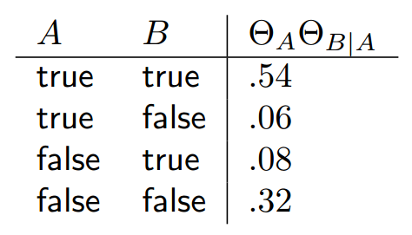
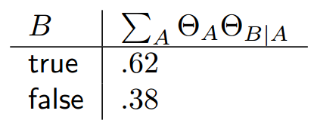
There are two tables that contain variable A.
Multiply these tables first and then sum out variable A from the resulting table
Summing out variable A:

Slide 18
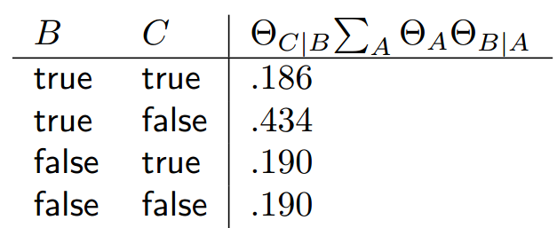
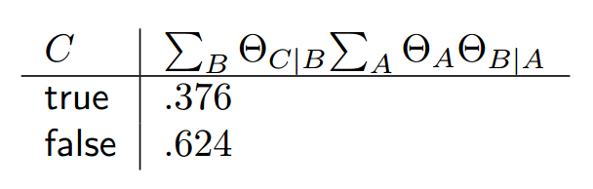
We have two tables and B is appearing in both the tables. To eliminate B, first multiply the tables.
Summing out variable B:

